Slide 1
Angular JS

Slide 2
What is AngularJS?
AngularJS is a JavaScript framework.
It can be added to an HTML page with a <script> tag.
AngularJS extends HTML attributes with Directives, and binds data to HTML with Expressions.
Developed by google and released 2010
Notes:
https://medium.com/@aakashgarg3108/introduction-to-servicenow-jelly-scripting-509a51c64147

Slide 3
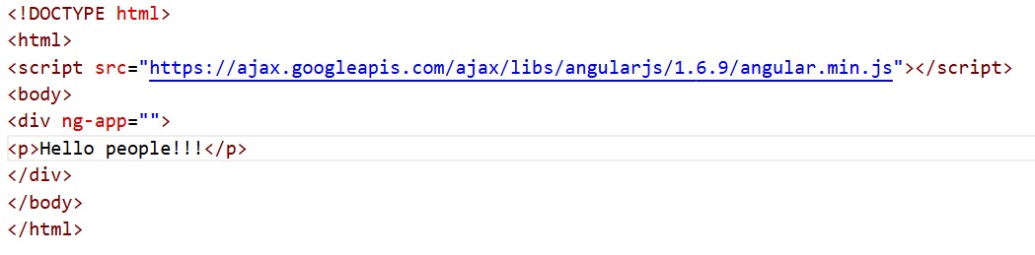
What is AngularJS?
AngularJS is distributed as a JavaScript file, and can be added to a web page with a script tag:
<script src="https://ajax.googleapis.com/ajax/libs/angularjs/1.6.9/angular.min.js"></script>
Notes:
https://medium.com/@aakashgarg3108/introduction-to-servicenow-jelly-scripting-509a51c64147

Slide 4
Why AngularJS?
Two-way data binding
MVC architecture
Dependency Injection
Directives extend HTML
Notes:
https://medium.com/@aakashgarg3108/introduction-to-servicenow-jelly-scripting-509a51c64147

Slide 5
MVC Pattern in AngularJS
Model → Data
View → HTML
Controller → Logic
Draw diagram:
User → View → Controller → Model → View updates
Notes:
https://medium.com/@aakashgarg3108/introduction-to-servicenow-jelly-scripting-509a51c64147

Slide 6
How AngularJS Works
Browser loads HTML
AngularJS bootstraps app
Creates scope
Binds data to DOM
Watches for changes
Mention briefly:
Service Portal uses this same mechanism internally.
Notes:
https://medium.com/@aakashgarg3108/introduction-to-servicenow-jelly-scripting-509a51c64147

Slide 7
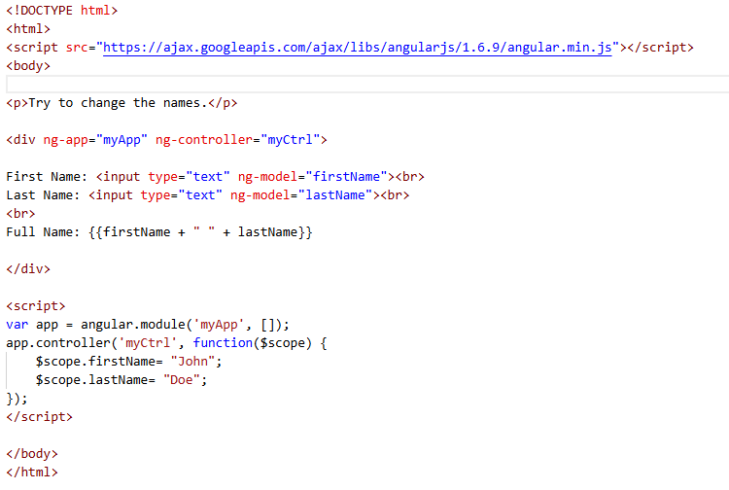
AngularJS Applications
AngularJS modules define AngularJS applications.
AngularJS controllers control AngularJS applications.
The ng-app directive defines the application, the ng-controller directive defines the controller.
Notes:
https://medium.com/@aakashgarg3108/introduction-to-servicenow-jelly-scripting-509a51c64147

Slide 8
Creating a Module
Module is the container of application components.
var app = angular.module("myApp", []);
Key Points:
First parameter = name
Second parameter = dependencies
ng-app Directive : Defines AngularJS application root.
<div ng-app="myApp">
Explain:
This tells Angular where the app starts.
Note: Only one ng-app is usually used.
Notes:
https://medium.com/@aakashgarg3108/introduction-to-servicenow-jelly-scripting-509a51c64147

Slide 9
Controllers
Controller Responsibilities:
Handle UI logic
Manage data
Connect model and view
Explain:
Controller is like brain of the UI.
app.controller("mainCtrl", function($scope){
$scope.name = "Sandy";
});
ng-controller
<div ng-controller="mainCtrl">
{{ name }}
</div>
Explain:
Controller attaches data to scope.
Notes:
https://medium.com/@aakashgarg3108/introduction-to-servicenow-jelly-scripting-509a51c64147

Slide 10
Controllers
What is $scope?
Communication bridge between controller and view
Stores variables and functions
Explain visually:
Controller → $scope → View
Notes:
https://medium.com/@aakashgarg3108/introduction-to-servicenow-jelly-scripting-509a51c64147

Slide 11
Data Binding
What is Data Binding?
Automatic synchronization between model and view.
Explain:
If model changes → UI updates
If UI changes → model updates
This is core AngularJS concept.
Expressions {{ }}
Used to display data.
    {{ 5 + 5 }}
    {{ name }}
Notes:
https://medium.com/@aakashgarg3108/introduction-to-servicenow-jelly-scripting-509a51c64147

Slide 12
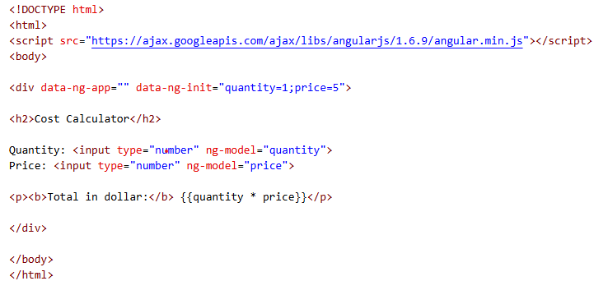
Data Binding
Two-Way Data Binding
<input ng-model="name">
<p>{{ name }}</p>
Explain:
Change input → view updates
Change model → input updates
VERY IMPORTANT concept.
One-Way vs Two-Way Binding
Explain difference clearly.
Traditional JS:
Manual DOM update.
AngularJS:
Automatic update.
Notes:
https://medium.com/@aakashgarg3108/introduction-to-servicenow-jelly-scripting-509a51c64147

Slide 13
Directives
Built-in Directives
What is a Directive?
Directive is an HTML attribute that extends HTML functionality.
Starts with ng-
Extends HTML behavior
Notes:
https://medium.com/@aakashgarg3108/introduction-to-servicenow-jelly-scripting-509a51c64147

Slide 14
Directives
ng-model
The ng-model directive binds the value of HTML controls (input, select, textarea) to application data.
The ng-model directive can also:
Provide type validation for application data (number, email, required).
Provide status for application data (invalid, dirty, touched, error).
Provide CSS classes for HTML elements.
Bind HTML elements to HTML forms.
ng-click
used for Event handling
<button ng-click="count = count + 1">Click</button>
Notes:
https://medium.com/@aakashgarg3108/introduction-to-servicenow-jelly-scripting-509a51c64147

Slide 15
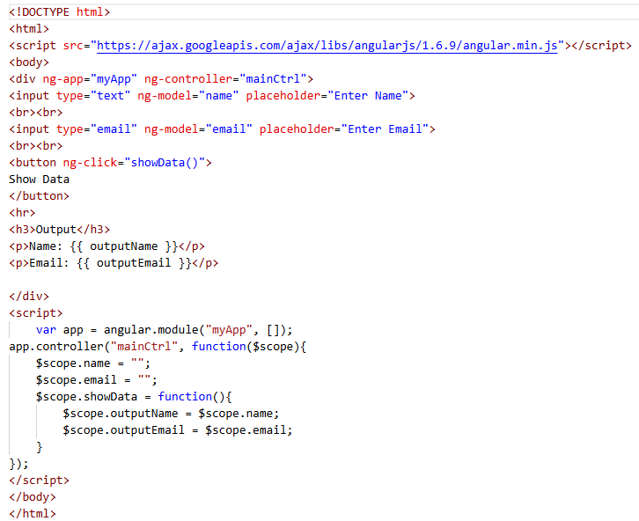
Directives example
Notes:
https://medium.com/@aakashgarg3108/introduction-to-servicenow-jelly-scripting-509a51c64147

Slide 16
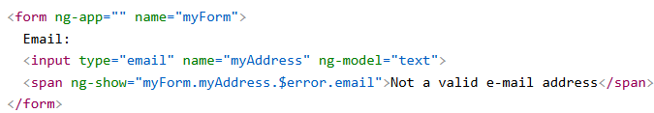
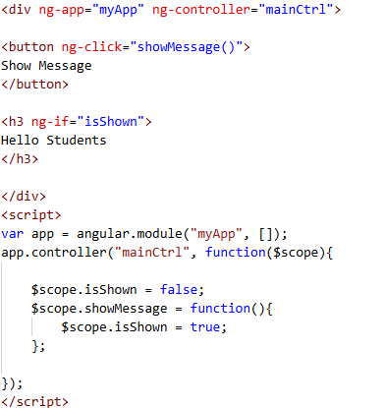
Directives
ng-show / ng-hide
Conditional visibility.
ng-if
Difference between:
ng-if (removes from DOM)
ng-show (just hides)
Notes:
https://medium.com/@aakashgarg3108/introduction-to-servicenow-jelly-scripting-509a51c64147

Slide 17
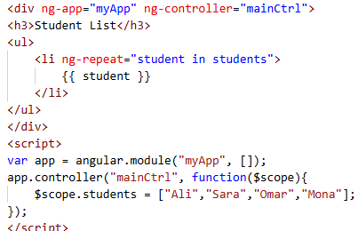
Directives
ng-repeat :Very important slide.
Used for: Looping arrays.
Explain:
Looping over arrays.
Notes:
https://medium.com/@aakashgarg3108/introduction-to-servicenow-jelly-scripting-509a51c64147

Slide 18
Task
Build a simple Login Form UI using AngularJS directives with good design.
Requirements:
Create a login form that contains:
  Student Name input
  Password input
  Checkbox
Add a Login Button:
  When clicked, copy the student name to an output variable using ng-click.
Implement form validation:
  Both username and password fields are required.
  Disable the login button if the form is invalid.
Display Section:
  Show the student name using ng-if or ng-show/ng-hide.
  Display a message only if the checkbox is selected.
Use simple and good clean UI design using bootstap.
Notes:
https://medium.com/@aakashgarg3108/introduction-to-servicenow-jelly-scripting-509a51c64147

